Slide 1
Digital Images
An image is a two-dimensional rectilinear of pixels that gives a pictorial representation of something.
An image can also be defined as a two-dimensional function f(x,y) where X and Y are spatial coordinates used in a coordinate system to define the precise location of a point or object within a multi-dimensional space (2D, 3D, or more), essential for mapping, navigation, and computer graphics to accurately place things relative to each other or a fixed reference), and f at any pair of coordinates (x,y) is called the intensity.
When the x, y, and f are all finite then the image is called a digital image.

Slide 2
What is Digital Image Processing?
Digital Image Processing is a process of analysis and manipulation of images via digital computer to get some information. In a broader sense, one can say it is a processing of two-dimensional data.
Digital Image Processing focuses on two major tasks:
  Improvement of pictorial representation for human interpretation
  Processing of image data for storage, transmission, and representation for autonomous machine perception.

Slide 3
What is a Pixel?
In image processing, a pixel (short for "picture element") is the smallest unit of a digital image, a single dot or square that holds a specific color and brightness value, forming a grid that creates the entire picture. Pixels are the fundamental building blocks, with more pixels (higher resolution) resulting in sharper, more detailed images, and their color information (often RGB) is crucial for manipulation tasks like filtering and contrast adjustment.
Key Aspects of Pixels:
Building Blocks: Each pixel has a numerical value representing its color, typically using the Red, Green, Blue (RGB) model, where each color channel gets a set number of bits (e.g., 8 bits for over 16 million colors).
Resolution:
An image's resolution is defined by the total number of pixels (e.g., 1920x1080).
Image Processing:
Techniques work on these individual pixel values; for example, contrast adjustment involves mathematically changing the brightness values of pixels.
Location:
Pixels are located at specific coordinates (x, y) within the image grid, starting from (0,0) at the top-left.
In Simple Terms:
  Imagine a mosaic made of tiny colored tiles; each tile is a pixel. In image processing, software changes the color of these "tiles" to alter the image, making it brighter, sharper, or changing specific objects
Millions of pixels arranged in rows and columns (a grid or bitmap) form a digital image.

Slide 4
History
The birth of the Digital Image Processing was in 1960. The first picture of the moon was taken by U.S. spacecraft Ranger 7 to Jet Propulsion Laboratory in 1964 which serves as the basis of future image processing. In the year 1970 image processing was used in medical imaging, astronomy, and remote sensing. From 1960 to today's date image processing has seen tremendous growth.

Slide 5
Applications of Digital Image Processing
Improve visual appeal
  Make images more pleasing for general viewing.
Increase interpretability
      Make features easier for humans to see (e.g., medical scans, satellite imagery).
Aid analysis
      Prepare images as better input for automated processes like object recognition.
Image enhancement
      Digital Image Processing analyzes and manipulates the image to make it more informative for human interpretation and make it more suitable for better representation of the image.

Slide 6
Applications of Digital Image Processing
Automatic inspection
  In a bottling plant, Digital Image Processing checks the quality of the product and detects empty or partially filled bottles.
  Industries such as automotive, electronics, and pharmaceuticals, demonstrating how automated systems enhance defect detection, reduce human error, and increase production efficiency.

Slide 7
Automatic inspection
How It Works
Image Acquisition: Cameras capture high-resolution images of products on assembly lines, sometimes using specialized lighting (IR, X-ray).
Image Preprocessing: Software cleans up images (noise reduction, contrast enhancement) for better analysis.
Feature Extraction: Algorithms identify key features like edges, shapes, textures, and colors.
Example -
Image Processing Steps for detecting defects in a metal nail:
1. Dataset Creation: A dataset was created by capturing multiple images of metal nails under different conditions. These images were then labelled using software to accurately classify them as defected or non-defected.
2. Pre-processing: The acquired images underwent several pre-processing steps to improve their quality. These steps included resizing for uniform dimensions, applying noise reduction techniques to remove distortions, and adjusting contrast to enhance defect visibility.
3. Training Model: The labelled and pre-processed images were used to train a machine learning model that distinguishes between defected and non-defected nails. The model was trained to recognize patterns from the dataset, ensuring high classification accuracy.
4. Implementation: The trained model was integrated into a conveyor belt system for real-time testing and validation. Although the system is still in development, it aims to automate the inspection process by analysing each nail as it moves

Slide 8
Applications of Digital Image Processing
Video Processing
  These techniques can spot moving stuff in videos.
Remote Sensing
  Digital Image Processing is essential in remote sensing and helps to analyze satellite and aerial images which helps with agriculture, environmental monitoring, and managing disaster.
Analysis & Decision:
  Traditional Methods: Template matching compares images to a "perfect" template.
  AI/Deep Learning: Convolutional Neural Networks (CNNs) learn from vast datasets to classify defects (e.g., scratch vs. dent) and even unseen flaws.

Slide 9
Applications of Digital Image Processing
Medical visualization
  In medicine, Digital Image Processing helps to enhance the quality of images and analyze medical images such as X-rays, MRI, and CT scans. It also helps to assist in diagnosis and treatment planning.
  X-Ray
  A heated filament (cathode) in a vacuum tube releases electrons. A high voltage accelerates these electrons toward an anode. When high-speed electrons strike the anode, most energy becomes heat (99%), but about 1% is converted into X-ray photons, which shoot out in a focused beam. The X-ray beam passes through the patient's body. Denser materials, like bone, absorb more X-rays, while softer tissues (muscle, fat) absorb less and let more pass through.
Image Processing (The Result)
Film Radiography:
  X-rays cause chemical changes in filmareas with more X-rays turn black, while blocked areas remain white (bones).
Digital Radiography:
  Detectors capture X-rays as light or electronic signals, which are then digitally processed by computers to reconstruct a high-contrast, detailed image for viewing on a screen.
The Final Image
White/Light Areas: High absorption by dense structures (bone, metal).
Black/Dark Areas: Low absorption, allowing X-rays to pass easily through soft tissues, air.

Slide 10
Applications of Digital Image Processing
Biometrics:
Digital image processing is used in security systems to perform tasks such as fingerprint recognition, facial recognition, and object tracking to improve security systems. Biometrics in digital image processing uses computer vision and image analysis to identify people from unique physical traits like faces, fingerprints, and irises, involving steps like image capture, pre-processing (noise reduction, enhancement), feature extraction (finding unique patterns), and matching against stored templates for secure identification, access control, and surveillance. Image processing is crucial for cleaning up raw biometric images (e.g., smoothing fingerprints, correcting facial angles) to ensure accurate feature extraction and reliable authentication.

Slide 11
Applications of Digital Image Processing
How Image Processing Works in Biometrics:
  Capture: A sensor (camera, scanner) acquires the raw image (face, fingerprint, etc.).
  Pre-processing: Techniques like filtering, smoothing, and noise reduction clean up the image to remove distortions, making features clearer.
  Feature Extraction: Algorithms identify and quantify unique points (like ridge endings in fingerprints or facial landmarks) to create a numerical template.
  Matching: The extracted template is compared to stored templates in a database to find a match for verification or identification.

Slide 12
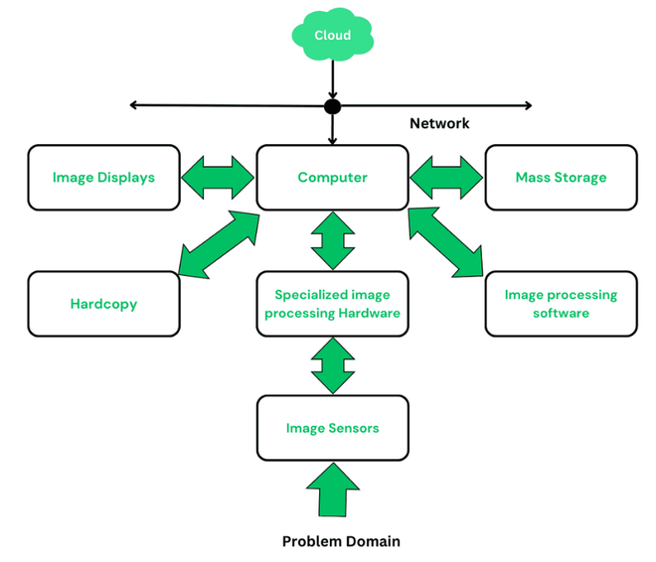
Components of Digital Image Processing

Slide 13
Components of Digital Image Processing
Image Sensors/sensing:
  To get digital images two subsystems are required: The first is a physical sensor that responds to the energy radiated by the object and the second is a device used for converting the physical sensing device into a digital form called a digitizer. A digitizer converts result outputs to digital data.
Specialized image processing hardware:
  To perform arithmetic and logical operations on the entire image a digitizer and hardware are used. This hardware is also called a front-end subsystem, and its speed is the most distinguishing characteristic. Because of the requirement of fast data throughput the typical main computer cannot handle it. Eg: Image Signal Processor (ISP), found in smartphones and cameras, which uses dedicated circuits for tasks like noise reduction, image correction.
Computer:
  The computer in an image processing system is a general-purpose computer that can range from a PC to a supercomputer. A well-equipped PC is beneficial for offline image processing tasks in image processing systems.

Slide 14
Components of Digital Image Processing
Image Processing Software:
  It consists of some specialized modules that perform some specific task. A well-designed package allows users to write minimum code and utilizes the specialized module. Highly developed software packages allow the integration of those modules and software commands from at least one computer language. MATLAB is a well-known image processing toolbox that is common in image processing systems.
Mass Storage:
  Mass storage is crucial in image processing applications when dealing with large sizes of images. An image of size 1024 × 1024 pixels requires one-megabyte storage if it is not compressed. Image processing systems face the challenge of storing thousands, or even millions, of images. Digital storage follows three principles :
  Short-term storage for use during processing.
  Online storage for relatively fast recall.
  Archival storage is characterized by infrequent access.
  Storages are measured in bytes(eight bits), Kbytes(one thousand bytes), Mbytes(one million bytes), Gbytes(Giga or one billion bytes), and Tbytes(Tera or one trillion bytes).
Image Displays:
  Image displays are mainly color, flat-screen monitors. Monitors are driven by the outputs of image and graphics display cards which play an integral part of the computer system.

Slide 15
Components of Digital Image Processing
Hardcopy:
  Hardcopy devices are used for recording images which include laser printers, film cameras, heat sensitive devices, ink-jet units, and digital units, such as optical and CD-ROM disks. The film is responsible for providing the highest resolution, but paper is the obvious medium for written material. Images are in a digital medium if image projection equipment is used. The final approach is to gain acceptance as the standard for image presentations.
Networking and Cloud:
  Networking and cloud communication are mostly used functions in today's era. Because of the large amount of data built-in in image processing applications, the key consideration in image transmission is bandwidth. When communicating with remote sites via the internet is not always as efficient, so to tackle this situation optical fibre and other broadband technologies are used. Image data compression plays a major role in the transmission of large amounts of image data.

Slide 16
Types of Images
Binary Images (Monochrome/1-bit):
  Simplest form, only two values (0 for black, 1 for white).
  Ideal for OCR, line drawings, or simple silhouettes, Optical Character Recognition (OCR), simple icons, document scanning.
Grayscale Images:
  Represent intensity from black (0) to white (255) using 8 bits per pixel ie 256 levels where 0=black and 255=white and the rest are shades of grey.
  Shows various shades of grey.
  Grayscale images are used in medical imaging (X-rays, CTs), computer vision/AI (object detection, feature extraction), digital photography/art (emphasizing texture, mood), printing/publishing (cost reduction in newspapers, books), and tech/UI (reducing eye strain, low-power modes) because they simplify data, focus on intensity/shape, and lower processing needs.

Slide 17
Types of Images
Colour Images (Truecolor/RGB):
  Different colors are formed by mixing shades. Uses different models.
  The primary is RGB(Red, Green, Blue) to create millions of colors, common for photos (e.g., JPEG, PNG).
  R occupies 8 bits, G occupies 8 bits, Blue occupies 8 bits.
  RGB occupies 24 bits.
  Photography, web graphics, most visual applications.
HDR (High Dynamic Range) Images:
  Contain a wider range of luminosity than standard images, capturing more detail in very bright and dark

Slide 18
Types of Images
Indexed Images:
  Use a limited color palette (e.g., 256 colors for GIF) with pixel values acting as indices to a separate color map.
  Indexed images are used in memory-efficient graphics (GIF, PNG), scientific visualization (remote sensing, medical imaging), and computer graphics for fast color lookups, leveraging a limited color palette to reduce file size and speed up processing, allowing easy color changes by just editing the palette.
  They're perfect for images with few distinct colors, like icons, logos, or simple diagrams, saving space by storing indices instead of full color data for every pixel, as seen in formats like GIF, PNG.
  Instead of storing RGB (Red, Green, Blue) values for every pixel, an indexed image stores a small number (an index) for each pixel, pointing to a specific color in a separate color palette. This significantly cuts down file size and processing time for images with a limited color range (up to 256 colors for 8-bit).

Slide 19
Types of Images
Multispectral/Hyperspectral Images:
  Capture data across many specific spectral bands (e.g., infrared, UV) for remote sensing and scientific analysis, often visualized by mapping bands to RGB.
  A multispectral image may be composed by several bands. For example, the Lansat 5 satellite produces 7 band images, with the wavelength of the bands being between 450 and 1250 nm.
  Hyperspectral imaging (HSI) is a method for capturing images that contain information from a broader portion of the electromagnetic spectrum
  Satellite imagery, environmental monitoring, astronomy.

Slide 20
Types of Images
Alpha Channel (RGBA):
  Color images with an added channel for transparency (Red, Green, Blue, Alpha).
  Alpha indicates how opaque each pixel is and allows an image to be combined over others using alpha compositing, with transparent areas and anti-aliasing of the edges of opaque regions.
  Example of an RGBA image composited over a checkerboard background that stores transparency information, defining how opaque or see-through each pixel is, crucial for layering images in graphics and video editing.

Slide 21
Fundamental Steps in Digital Image Processing
We can categorise the steps in digital image processing as three types of computerised processing, namely low level, mid level and high level processing.
Low Level Processing
  Low level processing involves basic operations such as image pre-processing, image enhancement, image restoration, image sharpening, etc. The main characteristic of low level processing is that both its inputs and outputs are images.
  Eg: Noise reduction, contrast adjustment, sharpening, blurring and color correction.
Mid Level Processing
  Mid level processing involves tasks like image classification, object identification, image segmentation, etc. The main characteristic of mid level processing is that its inputs are generally images whereas its outputs are attributes associated with image which are extracted from it.
  Eg: Image Segmentation (grouping pixels into objects/regions), Edge/Contour Detection (finding boundaries), Object Recognition (identifying shapes/features like curves or corners), and Shape Description (creating symbolic representations like skeletons or outlines for analysis).
High Level Processing
  High level processing involves making sense of ensemble of recognised object and cognitive tasks associated with computer vision. Eg: Face Recognition in Security, Medical Diagnosis from Scans.

Slide 22
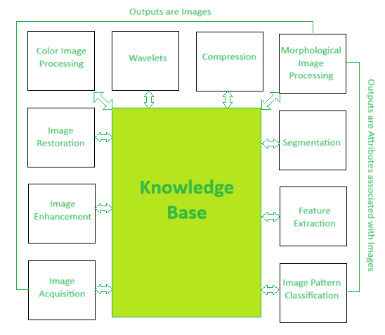
Fundamental Steps in Digital Image Processing

Slide 23
Fundamental Steps in Digital Image Processing
Image Acquisition:
  Capturing the raw image from a sensor (like a camera) and converting it into digital form (pixels).
Image Enhancement:
  Improving visual quality or highlighting features, e.g., adjusting brightness, contrast, or sharpening.
Image Restoration:
  Recovering a degraded image by removing noise or artifacts, aiming to restore its original appearance objectively.
Color Image Processing:
  Handling color images, including color modeling and transformations.
Wavelets:
  Analyzing images at different scales or resolutions.
Image Compression:
  Reducing file size for storage and transmission, crucial for efficiency.
Morphological Processing:
  Refining shapes and structures using operations like erosion and dilation to extract features. Eg: Fingerprint recognition
Image Segmentation:
  Dividing the image into meaningful regions or objects and their boundaries.
Representation & Description:
Converting segmented data into a format suitable for computer processing, focusing on boundaries or regions.

Slide 24
Fundamental Steps in Digital Image Processing
Object Recognition:
  Assigning labels or identifying objects based on their extracted features.
Knowledge Base:
  A structured repository of expert information, rules (like IF-THEN), and domain-specific data (features, patterns, noise types) that guides automated systems to interpret, analyze, and understand images for specific applications

Slide 25
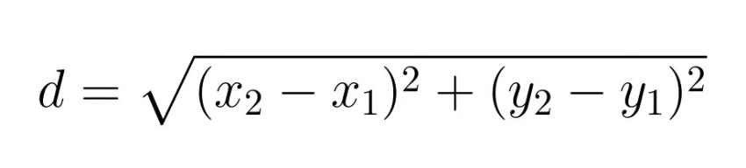
Distance Measure
A mathematical function calculating the separation or likeness between points in an image, often pixel coordinates or feature vectors.
Euclidean (L2):
  Straight-line distance, great for general comparison.
Manhattan (City Block): (4-connectivity)
  Sum of absolute differences in coordinates, good for grid-like movements.
  d4(p,q) = ∣x1−x2∣+∣y1−y2​∣
Chessboard (Chebyshev): (8-connectivity)
  Maximum absolute difference in coordinates, ideal for diagonal steps.
  d8(p,q) = max(∣x1−x2∣,∣y1−y2​∣)

Slide 26
Distance Measure
Dm distance (or m-distance) defines the shortest path between pixels, but only through pixels that are neighbors (4- or 8-connected) and belong to a specified intensity value set 'v'.

Slide 27
Distance Measure
Feature Comparison: Determines how "close" or similar visual features are, forming the basis for matching and retrieval.
Image Segmentation & Clustering: Groups similar pixels or objects, defining boundaries and regions.
Shape Analysis: Helps understand object shapes and sizes by measuring distances between foreground pixels.
Pattern Recognition: Essential for classifying patterns by comparing test samples to known ones.
Computer Vision Applications: Powers tasks like object detection in autonomous vehicles, content-based image retrieval, and medical imaging analysis.

Slide 28
Textbook reference –
  Digital Image Processing
  Textbook by Rafael C. Gonzalez and Richard E. Woods

